Slide 1
Weather traffic forecasting
Name-Shreya Vijay Shende

Slide 2
INTRODUCTION
Website traffic forecasting predicts the number of visitors or page loads for future dates.
Accurate traffic prediction helps organizations understand future demand.
It supports better resource allocation, server planning and business decision-making.
This project analyzes historical daily website traffic and predicts future traffic using multiple forecasting approaches.
Both time-series and machine-learning techniques are evaluated to identify the most effective model.

Slide 3
Historical Data → ML Forecasting → Better Decisions
PROBLEM STATEMENT & OBJECTIVES
Problem Statement
Website traffic varies over time due to weekly patterns, trends and other factors. Manual estimation may not accurately predict future traffic.
Objectives
Analyze historical website traffic data.
Perform data preprocessing and quality checks.
Identify important traffic patterns and trends.
Create time-series and machine-learning forecasting models.
Compare models using RMSE, MAE and MAPE.
Forecast future website traffic.
Develop a user-friendly Streamlit dashboard.

Slide 4
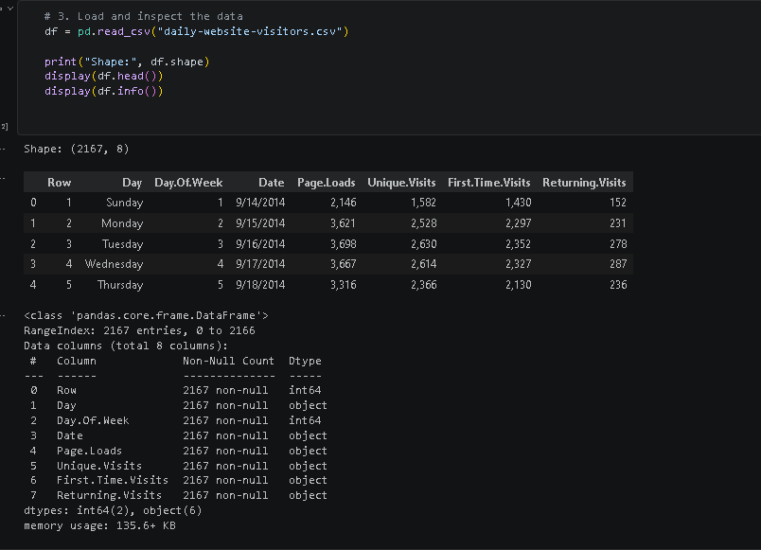
Main Features
1]Date
2]Page Loads
3]Unique Visits
4]First-Time Visits
5]Returning Visits
6]New Sessions
7]Returning Sessions
8]New Visits
The dataset contains continuous daily observations, making it suitable for time-series forecasting.
DATASET DESCRIPTION
Dataset: Daily Website Visitors
Total records: 2,167 daily observations
Time period: September 2014 – August 2020
Target variable: Page.Loads
Data contains daily website traffic and visitor information.

Slide 5
Raw Data
↓
Cleaning
↓
Date Processing
↓
Numeric Conversion
↓
Time Series Dataset
DATA PREPROCESSING
The following preprocessing steps were performed:
Converted the Date column into datetime format.
Sorted the data chronologically.
Removed duplicate dates where required.
Converted comma-separated traffic values into numeric format.
Checked for missing values.
Verified the daily time-series structure.
Set Date as the time-series index.
Interpolated missing values where necessary.
Prepared the cleaned dataset for forecasting and machine learning.

Slide 6
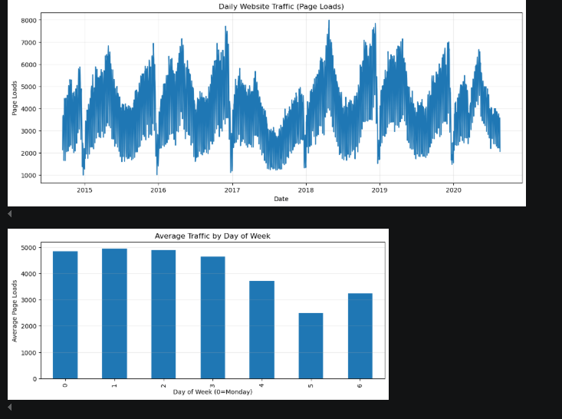
EXPLORATORY DATA ANALYSIS
The traffic data was analyzed to understand its behavior over time.
Key Analysis
Daily website traffic trend was visualized.
Weekly traffic patterns were analyzed.
Monthly traffic variations were studied.
High and low traffic periods were identified.
Historical patterns were used to design forecasting features.
Visualization
Daily traffic shows noticeable variations and recurring patterns, which can be useful for forecasting future website traffic.

Slide 7
FEATURE ENGINEERING
Time-series features were created to help machine-learning models learn historical traffic patterns.
Lag Features
Lag 1
Lag 2
Lag 3
Lag 7
Lag 14
Lag 21
Lag 28
#Rolling Features
7-day rolling mean and standard deviation
14-day rolling mean and standard deviation
28-day rolling mean and standard deviation

Slide 8
FORECASTING & MACHINE LEARNING MODELS
Multiple approaches were evaluated to identify the most suitable forecasting model.
Models Used
Time-Series Approaches
Weekly Seasonal Naive
Holt-Winters Exponential Smoothing
Machine Learning Approaches
Random Forest Regressor
Extra Trees Regressor
HistGradientBoosting Regressor
Data Split
The dataset was divided chronologically into:
80% Training Data
20% Testing Data
A chronological split was used to avoid future information being used during training.

Slide 9
MODEL EVALUATION
Models were evaluated using three performance metrics:
RMSE
Measures the magnitude of prediction errors. Lower RMSE indicates better performance.
MAE
Measures the average absolute difference between actual and predicted traffic. Lower MAE is better.
MAPE
Measures prediction error as a percentage. Lower MAPE indicates better forecasting accuracy.
Benchmark Results
Best benchmark model: Extra Trees Regressor
Model | RMSE | MAE | MAPE
Weekly Naive | 615.07 | 407.84 | 11.28%
Holt-Winters | 1413.52 | 1161.29 | 28.84%
Random Forest | 372.31 | 278.77 | 7.71%
HistGradientBoosting | 349.42 | 255.97 | 6.86%
Extra Trees | 347.28 | 254.97 | 6.86%

Slide 10
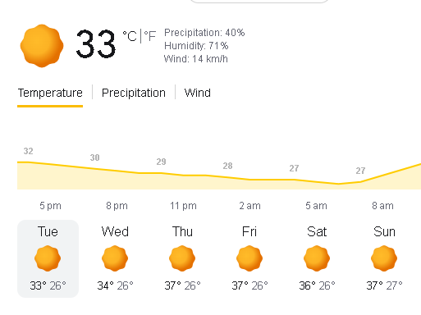
STREAMLIT WEB APPLICATION
A Streamlit-based interactive dashboard was developed for website traffic forecasting.
Dashboard Features
Website traffic overview
Total days and traffic KPIs
Daily traffic visualization
Weekday and monthly traffic analysis
Model performance comparison
Actual vs predicted traffic
Future traffic forecasting
Feature importance visualization
Forecast data download as CSV
Technologies
Python | Streamlit | Pandas | NumPy | Scikit-learn | Statsmodels | Matplotlib

Slide 11
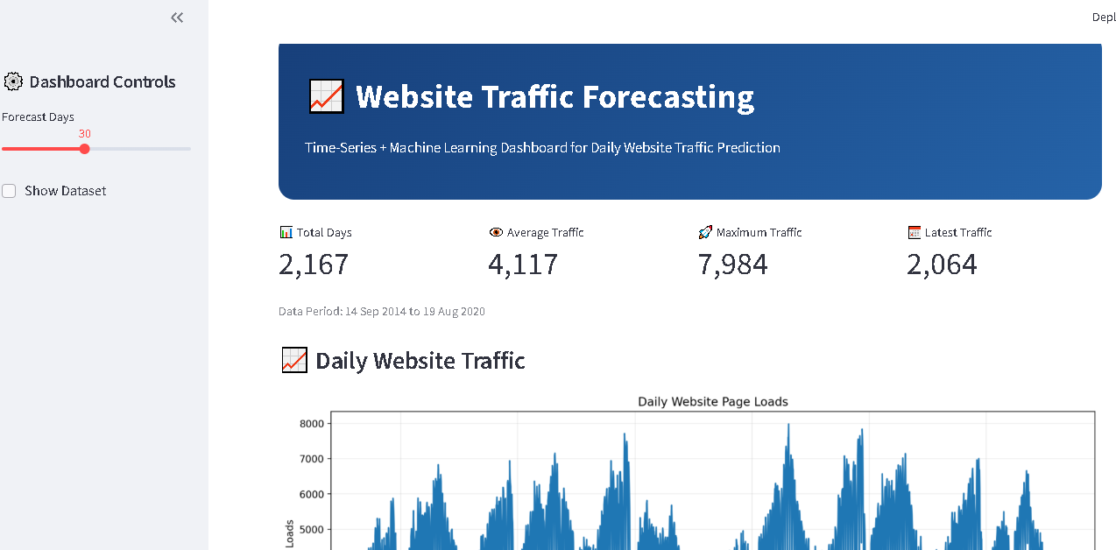

Slide 12

CONCLUSION & FUTURE SCOPE
Conclusion
Historical website traffic was successfully analyzed and forecasted.
Time-series and machine-learning approaches were compared.
Feature engineering improved the ability to capture historical traffic patterns.
Extra Trees achieved the best benchmark performance with an RMSE of approximately 347.28 and MAPE of 6.86%.
An interactive Streamlit dashboard was developed for visualization and forecasting.
Future Scope
Develop a true hybrid/ensemble forecasting model.
Incorporate external factors such as holidays, campaigns and marketing events.
Experiment with advanced models such as XGBoost, LightGBM and LSTM.
Deploy the forecasting system as a production web application.
Add automated model retraining with new traffic data.

